Slide 1

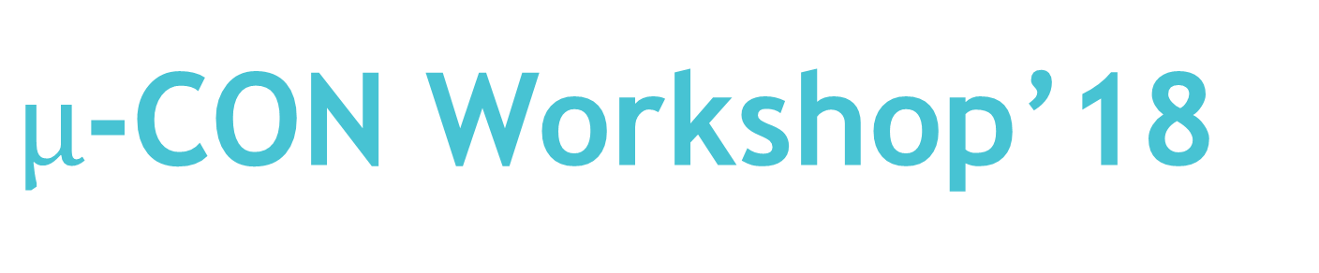
$µ$-CON Workshop’18
“ Wireless Game Controller
Using Infrared Data Transmission ”

Slide 2
Session 5: IR Communication
30th Sep’18, 14:00 to 17:00 Hrs.

Slide 3
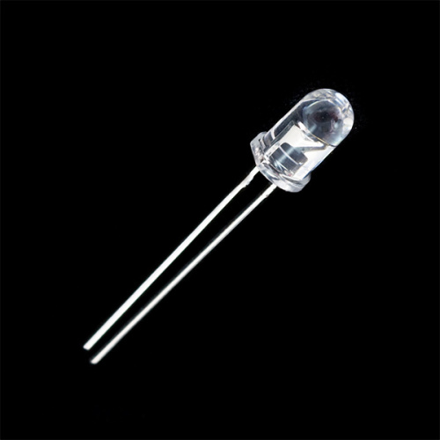
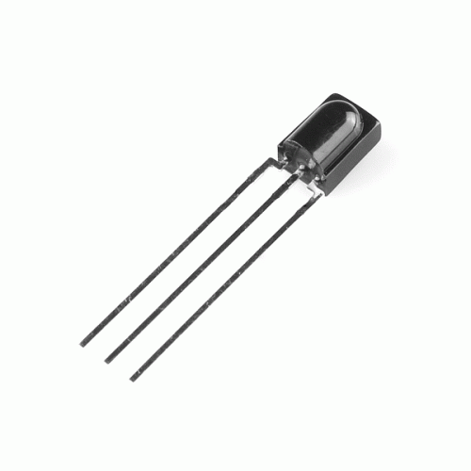
IR Communication:
Communication in which IR rays are involved.
Most common, inexpensive, and easy to use mode of communication.
IR is undetectable by human eye. It has a wavelength longer than the visible spectrum.
Wavelength: 7oo nm to 1 mm.

Slide 4

LET’S THINK FOR A MOMENT :
In our surroundings, there are a number of entities producing IR rays. For example - Sun rays emit IR radiations , CFLs emit IR rays and many more. So when you press a button on a remote, how does your device detect the signal accurately, despite having too many interferences/ disturbances ?
Answer is Modulation.

Slide 5
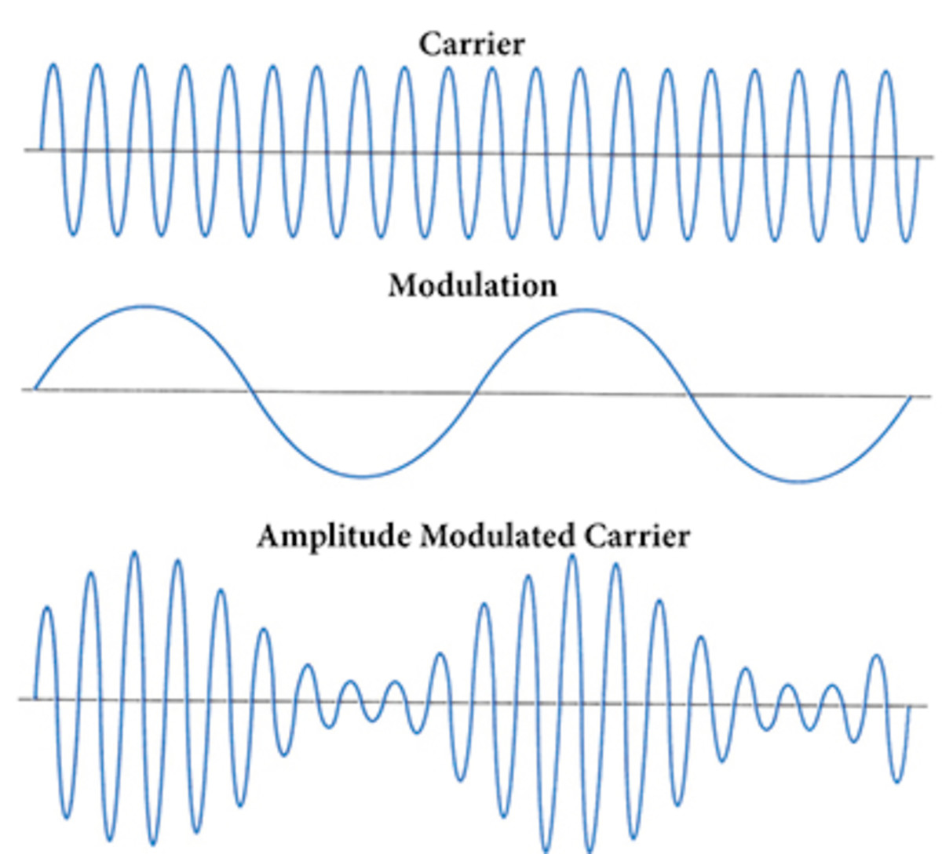
Modulation:
Varying of properties of carrier signal with message signal.
Used to change the signal characteristics
In IR communication, commonly used modulation scheme is 38kHz Modulation.
Other modulation techniques 30,38,40,56 kHz.
Q. Why 38kHz modulation technique is so common?

Slide 6
Why 38kHz modulation technique is so common?
ANS. There are few natural sources that have the regularity
of 38kHz signal, so the signal will standout among the others and will be easily identified. Also, if we consider Average Power Consumption 38kHz will have the most suitable value. Hence we generally go for 38kHz modulation technique.

Slide 7
Basic Block Diagram for IR Communication
TRANSMITTER
RECEIVER
IR Emitter
Sensor

Slide 8
LET’S THINK FOR A MOMENT AGAIN :
Assume that you have a SAMSUNG TV at home. Now you purchased a brand new SONY TV. What happens if you try to operate the SONY Tv using a SAMSUNG remote ? Will it work? Try the opposite way. Operate SAMSUNG TV using SONY remote?
Why did it not work ?
Ans: Different manufacturers uses different “PROTOCOLS”

Slide 9
What is PROTOCOL:
Basically it is a set of rules which both transmitter as well as receiver have to follow in order to achieve a meaningful communication.
Analogy : ‘Language’. For example English is the most common (language)protocol followed in our campus.
Example: NEC, SONY, RECS-80, RC-5/6
(Prone to
interference)
(Phillips)

Slide 10
NEC-Protocol:
Based on pulse distance encoding.
Logical 0 : 562.5µs Pulse Burst followed by 562.5µs space ( Digital LOW).
Logical 1: 562.5µs Pulse Burst followed by 1.6875ms space.
562.5µs
562.5µs
562.5µs
1.6875ms
Logical 0
Logical 1
Total time: 1.125ms
Total time: 2.25ms

Slide 11
NEC-Protocol(Contd.):
Start Bit or Start of Frame :
9ms Pulse burst followed by 4.5ms of space.
End Bit or End of Frame :
562.5µs Pulse burst.
9ms
4.5µs
562.5µs
SOF
EOF
Total time: 13.5ms
Total time: 562.5µs

Slide 12
NEC-Protocol(Contd.):
Start of Frame
SOF
Message/Info
End of Frame
EOF
Message/Info has 4 parts –
Address of receiving device (8-bit)
Inv. Of Address (8-bit)
Data or Actual Message (8-bit)
Inv. Of Data (8-bit)
In total 32-bit of data in message frame.

Slide 13
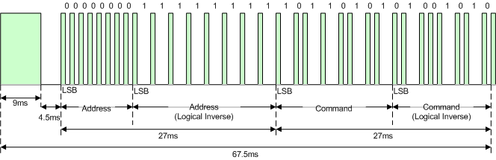
NEC-Protocol(Contd.):
LSB is sent first (LSB - MSB).

Slide 14

NEC-Protocol(Contd.):
Pulse burst means the above signal is modulated with 38kHz Pulse.
Zoom

Slide 15
Q.:
Suppose A= 01101010 and D= 00110111, write the complete 32-bit signal code following NEC protocol .
Ans: 01010110 10101001 11101100 00010011

Slide 16
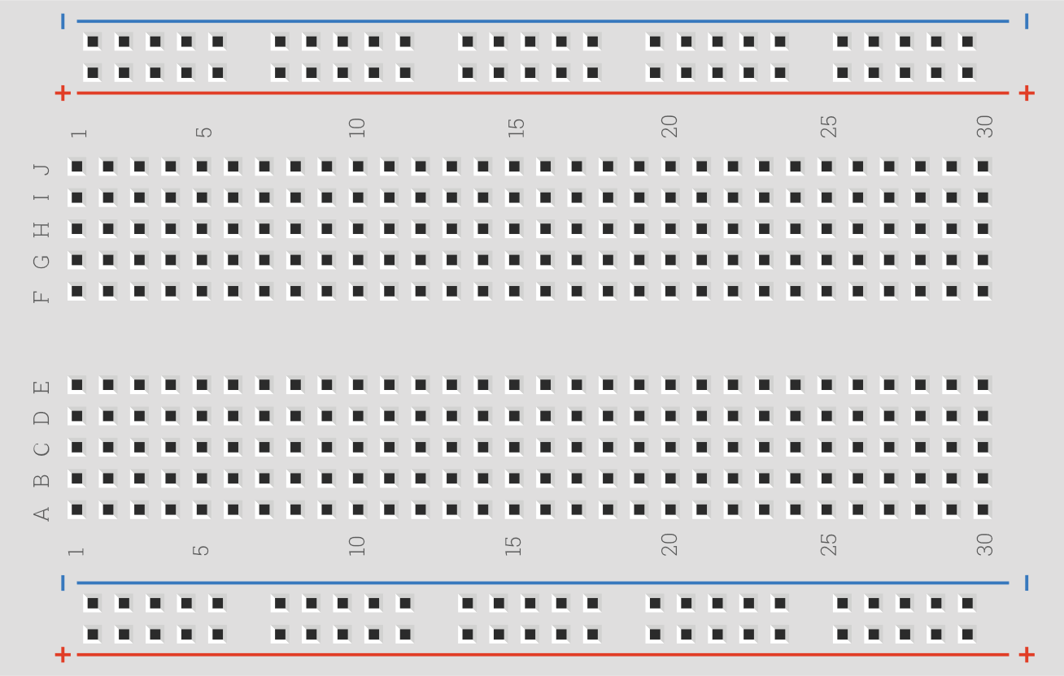

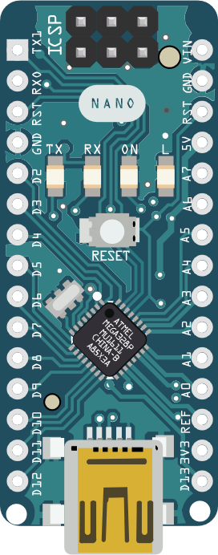
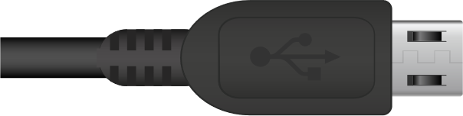
Circuit Connection:
Transmitter

Slide 17

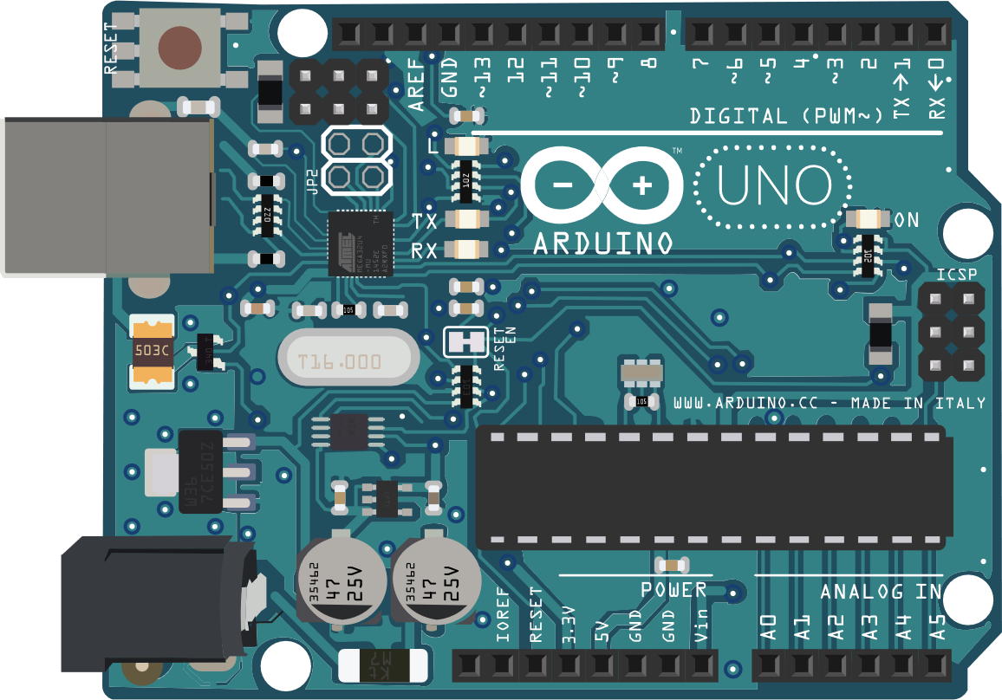
Circuit Connection:
Receiver

Slide 18

Coding:
f = 38kHz , so T = 26.31µs
For pulse, 50% duty cycle , T_{o}= 26.31/2 = 13.15 µs
Timer 0, CTC Mode, No prescaling. T_{clk}=0.0625µs
No. of Ticks, n= $\frac{13.15}{0.0625}$ = 210.4 OCR0A=210.
Timer 0 interrupt on compare match to toggle the LED Pin.
Timer 1, CTC Mode, 64 bit prescaling, OCR1A = variable

Slide 19
Coding(Contd.):
ISR(TIMER0_COMPA_vect) {
PORTD^=(1<<2);
}
ISR(TIMER1_COMPA_vect) {
TCCR1B=0x00;
TCCR0B=0x00;
PORTD=0x00;
}
void start_pulse() {
OCR1A=18000;
TCCR1B=(1<<CS11);
TCCR0B=(1<<CS00);
TCNT1=0;
TCNT0=0;
PORTD=0b00000100;
while(TCCR1B&(1<<CS11));
}
void start_delay() {
PORTD=0x00;
OCR1A=9000;
TCCR1B=(1<<CS11);
TCNT1=0;
while(TCCR1B&(1<<CS11));
}
void code_pulse() {
OCR1A=9000;
TCCR1B=(1<<CS10);
TCCR0B=(1<<CS00);
TCNT1=0;
TCNT0=0;
PORTD=0b00000100;
while(TCCR1B&(1<<CS10));
}
void delay_bit(int time_tic) {
PORTD=0x00;
OCR1A=time_tic;
TCCR1B=(1<<CS10);
TCNT1=0;
while(TCCR1B&(1<<CS10));
}
void send_code(int code){
start_pulse();
start_delay();
for(int i=0;i<32;++i) {
code_pulse();
if(code&0x80000000)
delay_bit(27000);
else
delay_bit(9000);
code<<=1;
}
code_pulse();
}

Slide 20
Coding(Contd.):
#include<avr/io.h>
#include<avr/interrupt.h>
uint32_t code_ON=0b10110010010011011111001000001101;
uint32_t code_OFF=0b10110010010011010110001010011101;
uint32_t code_INC_BRIGHT=0b10110010010011010101011010101001;
uint32_t code_DEC_BRIGHT=0b10110010010011010101001010101101;
uint32_t code;
volatile int count=0;
// ISR(TIMER0_COMPA_vect)
// ISR(TIMER1_COMPA_vect)
ISR(TIMER2_OVF_vect) {
++count;
if(count>=2) {
count=0;
TCCR2B=0x00;
}
}

Slide 21
Coding(Contd.):
// void start_pulse()
// void start_delay()
// void code_pulse()
// void delay_bit(int time_tic)
void delay_time() {
PORTD=0x00;
TCCR2B=(1<<CS22)|(1<<CS21)|(1<<CS20);
TCNT2=0;
while(TCCR2B&(1<<CS20));
}
void send_code(int code_value) {
if(code_value==1) {
code=code_ON;
}
else if(code_value==0) {
code=code_OFF;
}
else if(code_value==2) {
code=code_INC_BRIGHT;}
else if(code_value==3) {
code=code_DEC_BRIGHT;
}
start_pulse();
start_delay();
for(int i=0;i<32;++i) {
code_pulse();
if(code&0x80000000) {
delay_bit(27000);
}
else {
delay_bit(9000);
}
code<<=1;
}
code_pulse();
code=0;
}

Slide 22
Coding(Contd.):
int main() {
TCCR0A=(1<<WGM01);
TCCR1A=(1<<WGM12);
TIMSK0=(1<<OCIE0A);
TIMSK1=(1<<OCIE1A);
TIMSK2=(1<<TOIE2);
OCR0A=210;
sei();
DDRD=0b00000100;
PORTD=0x00;
Serial.begin(9600);
while(1) {
Serial.println("Off");
send_code(0);
delay_time();
Serial.println("On");
send_code(1);
delay_time();
send_code(2);
delay_time();
send_code(3);
delay_time();
}
PORTD=0x00;
return 0;
}

Slide 23
DECODING

Slide 24
To decode the signal we first need a detector which detects an IR radiation. We can’t use photodiode here because it will not distinguish between two different IR signals. Hence we use some other sensor which is TSOP17XX series. XX determines the frequency to which the sensor is sensitive. For example : TSOP 1738 is used for detecting IR radiations modulated to 38kHz frequency.

Slide 25
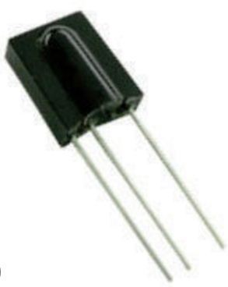
This module internally have Photodetector, IR filter, Preamplifier, PCM filter, PIN Diodes, Automatic Gain control, Band Pass filters.
TSOP 1738:
Basically what it does it will detect only those IR signal which frequency matches its design and then remove all the disturbances, filters it and remove the 38kHZ modulation wave and gives only a square wave as output.
Have 3 pins GND(1), V_{cc}(2) and Output(3).
2
3
1

Slide 26
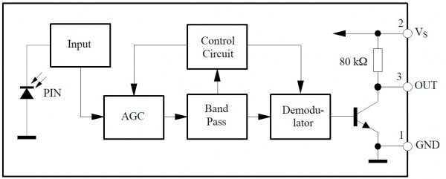
TSOP 1738 (Contd.):

Slide 27
TSOP 1738 (Contd.):
Normally Output is HIGH.
When signal falls on it, OUTPUT goes to LOW

Slide 28
So to detect the signal change we will use interrupt methods instead of polling. But of which type ? 1. Rising Edge 2. Falling Edge 3. Any logic change
ANS: Falling Edge

Slide 29
Circuit Connection:
Receiver

Slide 30
Coding:
Enable falling edge interrupt. Connect OUT to PIN2
Now timer for 1ms count (precise) we will use TIMER 0
Timer 0, CTC Mode, 64 bit prescaling This gives 1 tick = 4µs, this gives for 1ms we have to count 250 Ticks. So OCR0A = 250

Slide 31
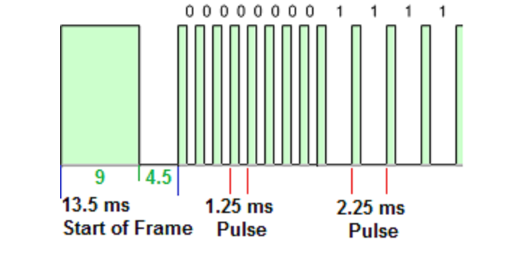
Coding(Contd.):
ISR(TIMER0_COMPA_vect) {
if(count<50)
++count;
}
ISR(INT0_vect) {
timer_value=count;
count=0;
TCNT0=0;
if(sof) {
++pulse_count;
}
if(timer_value>=13&&timer_value<=15) {
msg_bit=0;
sof=1;
pulse_count=-1;
}
else if((pulse_count>=0) && (pulse_count<=31)) {
if(timer_value>=2) {
msg_bit|=(uint32_t)1<<(31-pulse_count);}
else {
}
if(pulse_count==31) {
EICRA=(1<<ISC00);
}
}
else if(pulse_count>=32)
{
new_key = msg_bit;
pulse_count = -1;
sof=0;
EICRA=(1<<ISC01);
}
}

Slide 32
Coding(Contd.):
#include<avr/io.h>
#include<avr/interrupt.h>
#include<util/delay.h>
volatile int count=0;
volatile int timer_value=0;
volatile int pulse_count=-1;
int sof=0;
volatile uint32_t msg_bit=0;
volatile uint32_t new_key=0;
//ISR(TIMER0_COMPA_vect)
//ISR(INT0_vect
void setup_external_interrupt() {
EICRA=(1<<ISC01);
EIMSK=(1<<INT0);
}

Slide 33
Coding(Contd.):
int main() {
DDRD=0x00;
setup_external_interrupt();
init_timer0();
timer0_start();
sei();
Serial.begin(9600);
while (1) {
if(new_key) {
Serial.println(new_key,HEX);
new_key=0;
}
}
return 0;
}
void init_timer0() {
TCCR0A=(1<<WGM01);
TIMSK0=(1<<OCIE0A);
OCR0A=250;
}
void timer0_start() {
TCCR0B=(1<<CS01)|(1<<CS00);
TCNT0=0;
}
void timer0_stop() {
TCCR0B=0x00;
}

Slide 34
Thank You

